Slide 1
Parallelism Workshop
By Shirly Fang and Justin Li

Slide 2
Outline
Overview of Optimizations
Overview of OpenMP directives
Helpful Links and Tips
Parallelism Lab Office Hours
Slides: https://tinyurl.com/lab4workshop

Slide 3
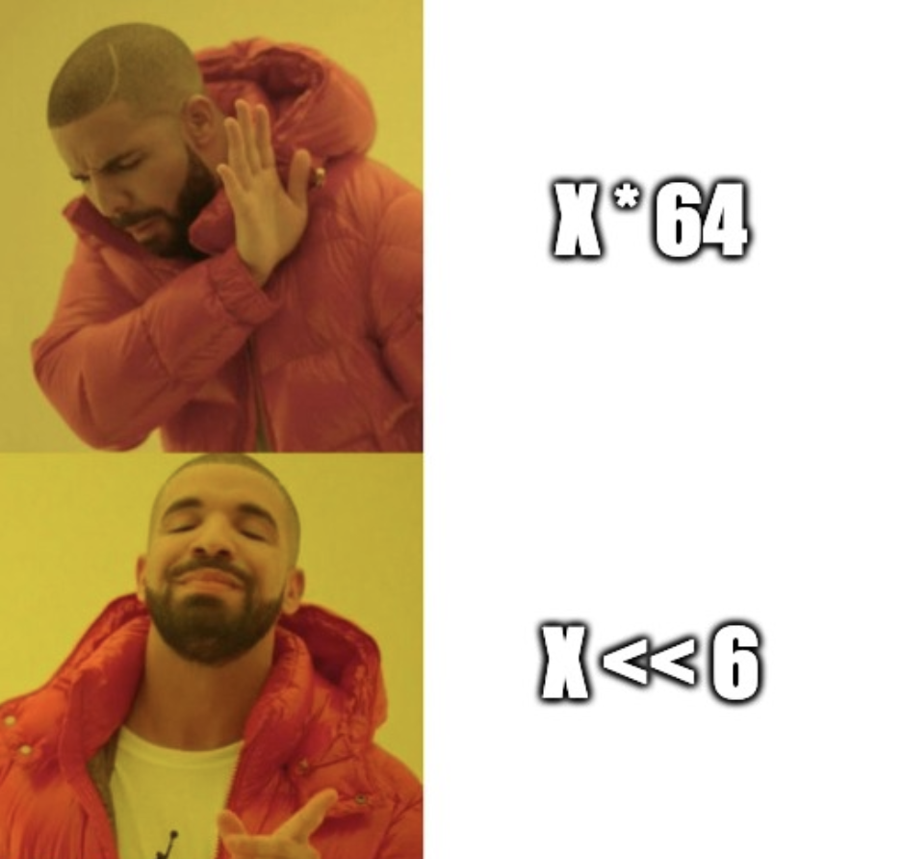
Strength Reduction
Replace expensive operations with
equivalent but less costly operations.

Slide 4
Strength Reduction
c = 7;
for (i = 0; i < N; i++) {
y[i] = c * i;
}
c = 7;
k = 0;
for (i = 0; i < N; i++) {
y[i] = k;
k = k + c;
}

Slide 5
Common Subexpression Elimination
A = B * C * D + d
U = B * C * D - e
temp = B * C * D
A = temp + d
U = temp - e

Slide 6
Code Motion
for (int i = 0; i < n); i++) {
for (int k =0; k < n; k++) {
r[i*DIM + k] += s[k +
i*DIM];
}
}
2n^2 times!
for (int i = 0; i < n); i++) {
int temp = i*DIM;
for (int k =0; k < n; k++) {
r[temp + k] += s[k +
temp];
}
}
n times!

Slide 7
Memory Aliasing
coolio(int* s, int* r, long n) {
for (int i = 0; i < n); i++) {
for (int k =0; k < n; k++)
{
r[i] += s[k + i*n];
}
}
}
coolio(int* s, int* r, long n) {
for (int i = 0; i < n); i++) {
int temp = 0;
for (int k =0; k < n; k++)
{
temp += s[k + i*n];
}
r[i] = temp;
}
}
Compiler doesn’t have to check if two variables are referencing the same thing
Notes:
Can’t

Slide 8
Loop Unrolling
coolio(int* s, long n) {
for (int i = 0; i < n; i++) {
func(s[i]);
}
}
coolio(int* s, long n) {
for (int i = 0; i < n-3; i+=4) {
func(s[i]);
func(s[i+1]);
func(s[i+2]);
func(s[i+3]);
}
}
Less loop overhead!
Notes:
Can’t

Slide 9
Reassociation
float sum = 0;
coolio(float* r, long n) {
for (int i = 0; i < n-1; i+=2) {
sum = (sum + r[i]) + r[i+1];
}
}
Operations in the next iteration can start earlier!
coolio(float* r, long n) {
for (int i = 0; i < n-1; i+=2) {
sum = sum + (r[i] + r[i+1]);
}
}
Notes:
Can’t

Slide 10
Tiling
for (i = 0; i <= N; i++)
for (j = 0; j <= N; j++)
dst[j*N+i] = src[i*N+j];
for (i = 0; i <= N-BLOCK; i+=BLOCK)
for (j = 0; j <= N-BLOCK; j+=BLOCK)
for (a = i; a < i+BLOCK; a++)
for (b = j; b < j+BLOCK; b++)
dst[b*N+a] = src[a*N+b];
for (; i <= N-1; i++)
for (; j <= N-1; j++)
dst[j*N+i] = src[i*N+j];
Reduces memory access latency

Slide 11
OpenMP: (Some) Useful Directives
Parallel
For
Critical
Reduction

Slide 12
Parallel
Creates several threads to execute the code
Of course, we usually want more control over how those threads run in parallel...
#include < stdio.h >
int main(void)
{
#pragma omp parallel
{
printf("Hello, world.\n");
}
return 0;
}

Slide 13
For
Splits the iterations of the corresponding loop in parallel over the threads
Used within the parallel construct, when you have multiple threads
Can shorten the “parallel” and “for” directives to “parallel for”
#pragma omp parallel num_threads(2)
{
...
#pragma omp for
for (int i = 0; i < 10; i++)
{
func();
}
}

Slide 14
For (continued)
Sometimes we want the variables used to be shared between the threads, and sometimes we want them to have their own private copies
To specify variables i, j, and k as private, we can use something like “#pragma omp parallel for private (i, j, k)”

Slide 15
Critical
Using the directive “#pragma omp critical” we can specify a certain section of the code to be executed sequentially, eliminating race conditions

Slide 16
Worksheet 7 Problem 5 (modified)
void func3(double *arrayX, double *weights,
double *x_e, int n)
{
double estimate_x=0.0;
int i;
for(i = 0; i < n; i++){
estimate_x += arrayX[i] * weights[i];
}
*x_e = estimate_x;
}

Slide 17
Worksheet 7 Problem 5 (modified)
void func3(double *arrayX, double *weights,
double *x_e, int n)
{
double estimate_x=0.0;
int i;
#pragma omp parallel
{
#pragma omp for
for(i = 0; i < n; i++){
estimate_x += arrayX[i] * weights[i];
}
}
*x_e = estimate_x;
}

Slide 18
Worksheet 7 Problem 5 (modified)
void func3(double *arrayX, double *weights,
double *x_e, int n)
{
double estimate_x=0.0;
int i;
#pragma omp parallel
{
#pragma omp for
for(i = 0; i < n; i++){
estimate_x += arrayX[i] * weights[i];
}
}
*x_e = estimate_x;
}
This leads to race conditions when updating “estimate_x”!

Slide 19
Worksheet 7 Problem 5 (modified)
void func3(double *arrayX, double *weights,
double *x_e, int n)
{
double estimate_x=0.0;
int i;
#pragma omp parallel
{
#pragma omp for
for(i = 0; i < n; i++){
#pragma omp critical
estimate_x += arrayX[i] * weights[i];
}
}
*x_e = estimate_x;
}

Slide 20
Worksheet 7 Problem 5 (modified)
void func3(double *arrayX, double *weights,
double *x_e, int n)
{
double estimate_x=0.0, tmp;
int i;
#pragma omp parallel private(tmp)
{
tmp = 0;
#pragma omp for
for(i = 0; i < n; i++){
tmp += arrayX[i] * weights[i];
}
#pragma omp critical
estimate_x += tmp;
}
*x_e = estimate_x;
}

Slide 21
Wouldn’t it be nice if there was a shorter way of doing all that work?

Slide 22
Reductions
void func3(double *arrayX, double *weights,
double *x_e, int n)
{
double estimate_x=0.0;
int i;
#pragma omp parallel for reduction(+:estimate_x)
for(i = 0; i < n; i++){
estimate_x += arrayX[i] * weights[i];
}
*x_e = estimate_x;
}

Slide 23
Links and Tips
Incrementally test out your optimizations/parallelizations!
Try one or two things at a time,
A bunch at once will prevent you from determining what actually works!
Feel free to look up how OpenMP directives work!
https://software.intel.com/en-us/articles/32-openmp-traps-for-c-developers
Some common mistakes to avoid!
https://www.openmp.org/wp-content/uploads/OpenMP-4.5-1115-CPP-web.pdf
A cheat-sheet that explains the common directives

